Slide 1
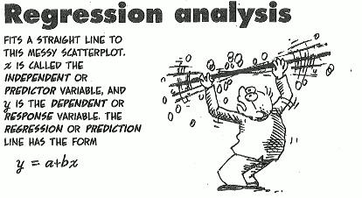

Welcome To….
(Part-2)

Slide 2
Learning Outcomes
When you will complete this chapter, you would be able to-
Development of Mathematical Equation for modeling the relationship of the variables.
Use of the Equation for the purpose of prediction.

Slide 3
Outlines
From this lecture, you are going to learn…
Definition of Regression with Examples
Define Independent and Dependent variables
Types of Regression with definition (Simple & multiple)
Fit/ Estimate Simple linear regression Line/model
Estimation of regression coefficients with interpretation
Interpret Coefficient of determination
(Part-1)
(Part-2)

Slide 4
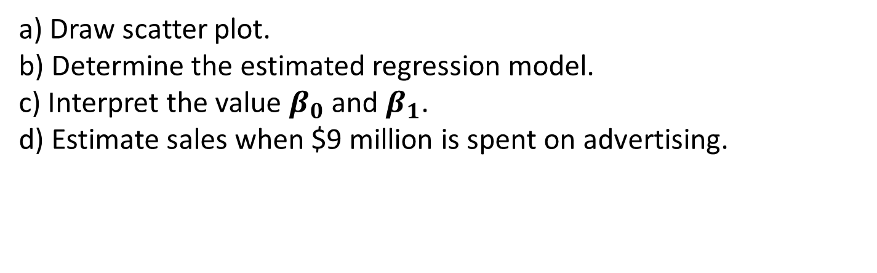
Example of Estimation of regression coefficients with interpretation
Problem: Suppose a company’s owner wants to forecast sales on the basis of advertising expenses. The owner would like to review the relationship between sales and the amount spent on advertising. Below is the information on sales and advertising expense for the last four months:
a) Draw scatter plot.
b) Determine the estimated regression model.
c) Interpret the value $β_{0}$ and $β_{1}$.
d) Estimate sales when $9 million is spent on advertising.

Slide 5
Example of Estimation of regression coefficients with interpretation
Solution:
a) If we plot the data and draw scatter plot we get as below plot

Slide 6
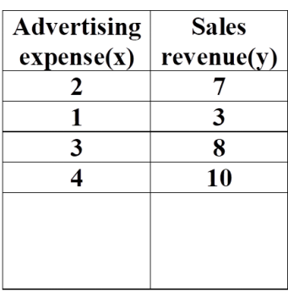
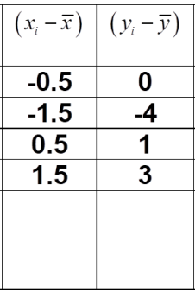
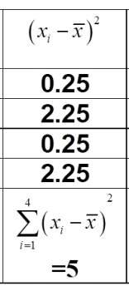
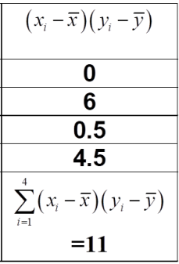
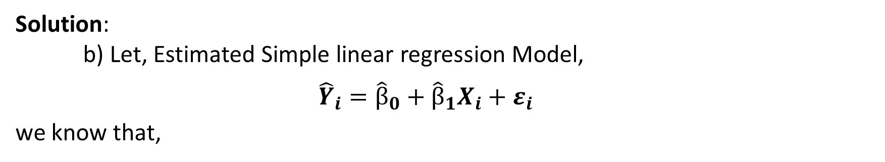
Example of Estimation of regression coefficients with interpretation
Solution:
b) Let, Estimated Simple linear regression Model,
$${\hat{Y}}_{i}={\hat{β}}_{0}+{\hat{β}}_{1}X_{i}+ε_{i}$$
we know that,

Slide 7
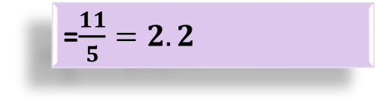
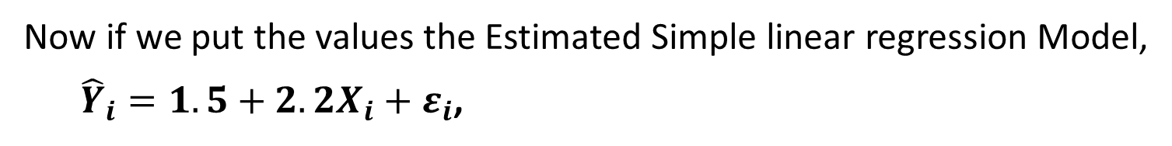
Example of Estimation of regression coefficients with interpretation
=$\frac{11}{5}=2.2$
=7-2.2*2.5
Now if we put the values the Estimated Simple linear regression Model,
${\hat{Y}}_{i}=1.5+2.2X_{i}+ε_{i}$,

Slide 8
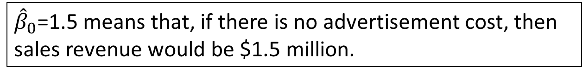
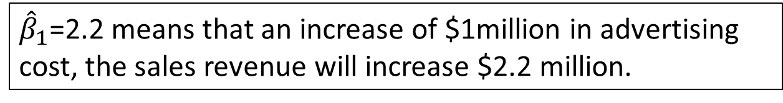
Example of Estimation of regression coefficients with interpretation
c) Interpretation:
${\hat{β}}_{1}$=2.2 means that an increase of $1million in advertising cost, the sales revenue will increase $2.2 million.
${\hat{β}}_{0}$=1.5 means that, if there is no advertisement cost, then sales revenue would be $1.5 million.

Slide 9
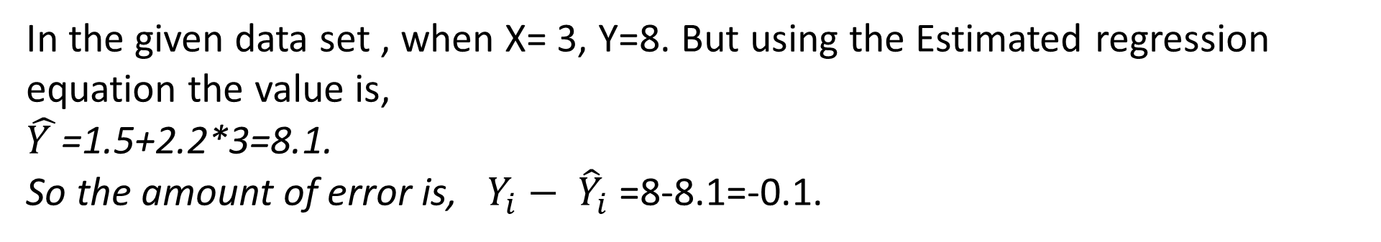
Prediction of Dependent variable in terms of independent variable and calculation of error
d) Now if x= 9, then
$\hat{Y }$=1.5+2.2*9=21.3.So, when advertisement cost is $9 million, the expected sales revenue would be $21.3 million.
Calculation of error for a single value:
In the given data set , when X= 3, Y=8. But using the Estimated regression equation the value is,
$\hat{Y }$=1.5+2.2*3=8.1.
So the amount of error is, $Y_{i}− {\hat{Y}}_{i}$ =8-8.1=-0.1.

Slide 10
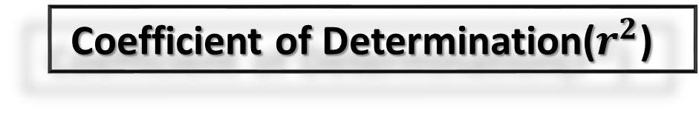
Coefficient of Determination($r^{2}$)

Slide 11



